Slide 1
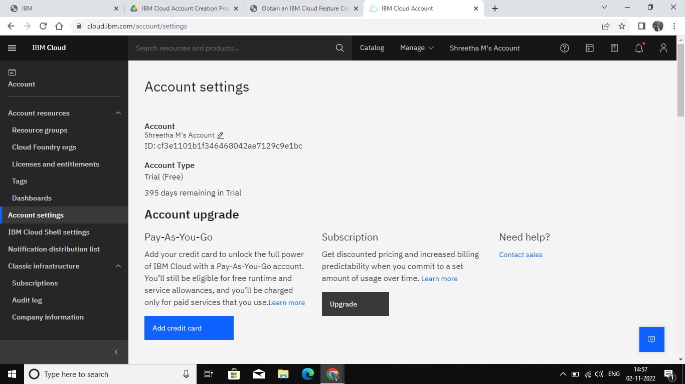
Environment Setup
IBM Cloud Account Creation
Team ID : PNT2022TMID07573
Shreetha Account

Slide 2

Shwathi.R.M Account

Slide 3

Soundarya Account

Slide 4

Sangeetha Account

